Slide 1
Mobot Software Design Specification

Slide 2
Block Diagram
LEFT PROXIMITY SENSOR
PIC16F877A MCU
PORTB.B4
PORTB.B3 / DIR_A
MOTOR DRIVE
PORTB.B2 / DIR_B
CCP1 / PWM_A
LEFT PROXIMITY SENSOR
PORTB.B5
CCP2 / PWM_B
MOTOR A/C
MOTOR B/D

Slide 3
Microcontroller Unit
Device | PIC16F877A
Clock Speed | 20MHz
CPU | RISC
PWM | 2, 10 bits resolution
ROM | 8192 Words, 14.3KB
RAM | 368 bytes
I/O | 33, Ports A, B, C, D, E
No of pins | 40 Pin PDIP
# instructions | 35

Slide 4

I/O Ports
PORTB is an 8-bit wide, bidirectional port. The corresponding data direction register is TRISB. Setting a TRISB bit (= 1) will make the corresponding PORTB pin an input (i.e., put the corresponding output driver in a High-Impedance mode). Clearing a TRISB bit (= 0) will make the corresponding PORTB pin an output (i.e., put the contents of the output latch on the selected pin).

Slide 5
Setting and Clearing an Output Pin
We Set and Clear a Pin using PORTx by Masking.
Setting a Pin to High
Clearing a Pin to Low

Slide 6



Pulse Width Modulator
PWM is a part of the CCP module. PWM1 is under CCP1 (RC2 Pin 17) and PWM2 is under (RC1 Pin 16) . PWM sets the Pulse width duration or Duty Cycle of a Square Wave.
Methods:
PWM1_Init(freq)
PWM1_Set_Duty(duty)
PWM1_Start()
PWM1_Stop()

Slide 7
Modules
The Mobot is implemented in Finite State Machine.
Two Managers will be Implemented to modularize the Mobot.
Input Manager
Manages the input sensor to set Mobot Input Sensing State.
Input: Sensor1 and Sensor2 Logic. (High - Object Detected, Low – No Object Detected).
Output: Input Sensing State
Motor Manager
Manages the control of Motor Drive.
Set and Clear Motor A and Motor B Direction(CW/CCW)
Set PWM control for Motor Speed. (DC= 0%- OFF, DC = 20% - SLOW Movement, DC – 50% -Backward Movement, and 100% - Fast movement for Forward)
Input: Input Manager Sensing State.
Output: Motor A and Motor B Direction and PWM control for Motor Speed.

Slide 8
Input Manager State Table
States | TASK | INIT | NO_SIGHT | LEFT_SIGHT | RIGHT_SIGHT | BOTH_SIGHT
INIT |  |  | NONE
NO_SIGHT |  |  |  | sensor1 and !sensor2 | !sensor1 and sensor2
LEFT_SIGHT |  |  | !sensor1 and !sensor2 |  | !sensor1 and sensor2 | sensor1 and sensor2
RIGHT_SIGHT |  |  | !sensor1 and !sensor2 | sensor1 and !sensor2 |  | sensor1 and sensor2
BOTH_SIGHT |  |  | !sensor1 and !sensor2 | sensor1 and !sensor2 | !sensor1 and sensor2

Slide 9
Input Manager State Machine

Slide 10
Motor Manager State Table
States | TASK | INIT | OFF | SLOW_LEFT | SLOW_RIGHT | FAST_FORWARD | BACKWARD | Delay
INIT |  |  | NONE
OFF | direction_a=A_CW , direction b = B_CCW, pwm_a =0, pwm_b =0 |  |  | [input]state = LEFT_SIGHT | [input]state = RIGHT_SIGHT |  | [input]state = RIGHT_SIGHT and [input]state = LEFT_SIGHT
SLOW_LEFT | direction_a = A_CCW , direction_b = B_CCW, pwm_a =20, pwm_b =20 |  |  |  | [input]state = RIGHT_SIGHT |  | [input]state = RIGHT_SIGHT and [input]state = LEFT_SIGHT
SLOW_RIGHT | direction_a = A_CCW , direction_b = B_CCW, pwm_a =20, pwm_b =20 |  |  | [input]state = RIGHT_SIGHT |  |  | [input]state = RIGHT_SIGHT and [input]state = LEFT_SIGHT
BACKWARD | direction_a = A_CCW , direction_b = B_CW, pwm_a =50, pwm_b =50 |  |  |  |  |  |  | NONE
DELAY | direction_a=A_CW , direction b = B_CCW, pwm_a =0, pwm_b =0, delay = 1sec , |  |  |  |  | delay
FAST_FORWARD | direction_a = A_CW , direction_b = B_CCW, pwm_a =100, pwm_b =100 |  | [input]state = NO_SIGHT

Slide 11
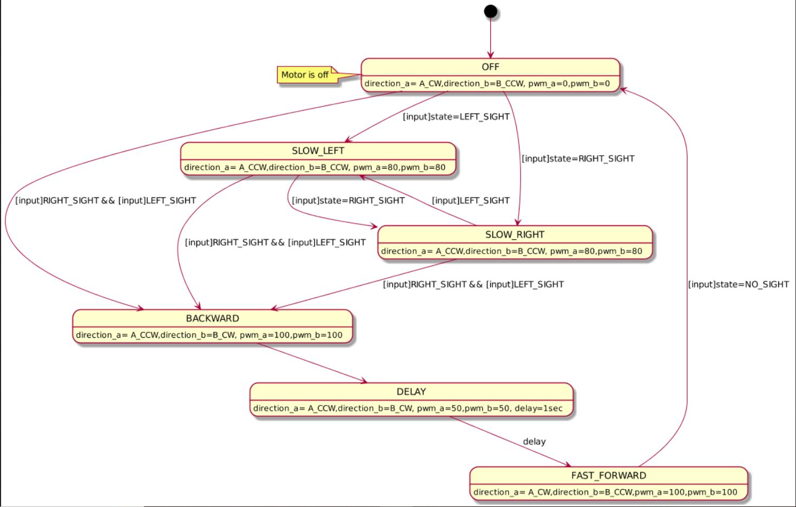
Motor Manager State Machine

Slide 12
Class Diagram

